Slide 1


VISVESVARAYA TECHNOLOGICAL UNIVERSITY BELAGAVI, KARNATAKA – 590018
Technical Seminar Presentation
on
“Wi-Vi TECHNOLOGY”
by:
Chandan Kumar N S (1SK20EC008)
Under the guidance of
Dr. Nagesh R
Asst. Professor, Dept. of ECE
Department of Electronics and Communication Engineering
Government Sri Krishnarajendra Silver Jubilee Technological Institute K. R. Circle, Bangalore - 560001

Slide 2
Presentation overview
Introduction
Wi-Vi Technology
Working of Wi-Vi
Challenges faced in designing Wi-Vi
Methodology and Implementation
Applications
Advantages & Limitations
Conclusion & Future scope
References

Slide 3
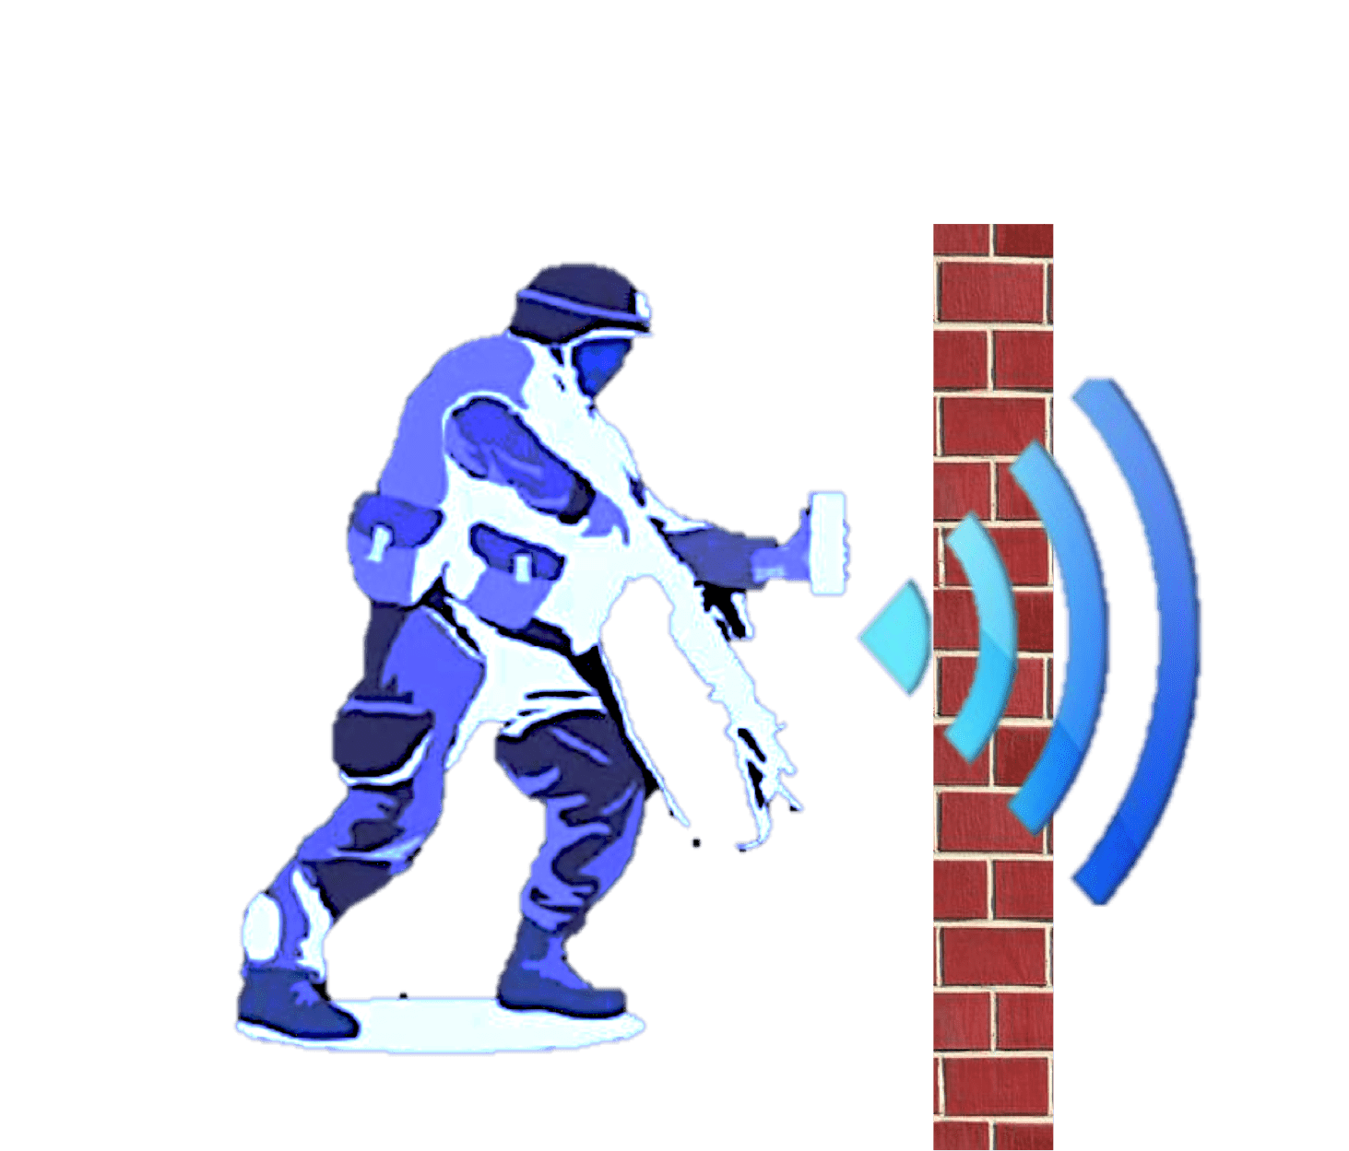
Introduction
Wi-Vi was created by Dina Katabi, a professor in MIT, and her student Fadel Adib.
Wi-Vi Stands for Wireless vision.
It captures moving object behind the wall.
Device uses typically Wi-Fi hardware.
Wi-Vi uses Wi-Fi OFDM signals in the ISM band (at 2.4 GHz) and typical Wi-Fi hardware.

Slide 4
-Wireless device
-capture moving object behind wall
-Low cost
-Low bandwidth
-Uses Wi-Fi signals
-Typically Wi-Fi Hardware
Wi-Vi Technology
-It is 3 antenna MIMO device
-Two transmitting and one receiving antenna

Slide 5
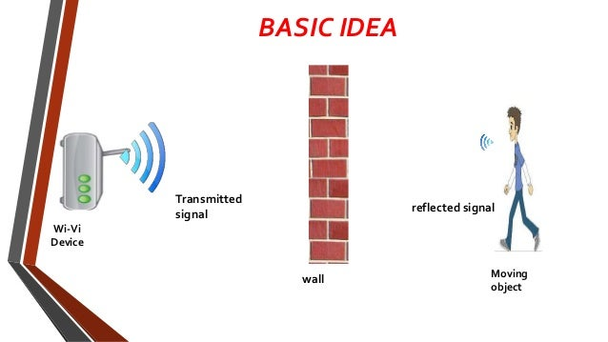
Wi-Vi Technology
Wi-Vi is a wireless device that captures moving objects behind a wall using Wi-Fi signal.
This technology uses reflected Wi-Fi signal to track movements of people behind wall.
Wi-Vi is small enough to be portably used and can be integrated in hand held devices.
Fig.1 Wi-Vi Basic Idea

Slide 6
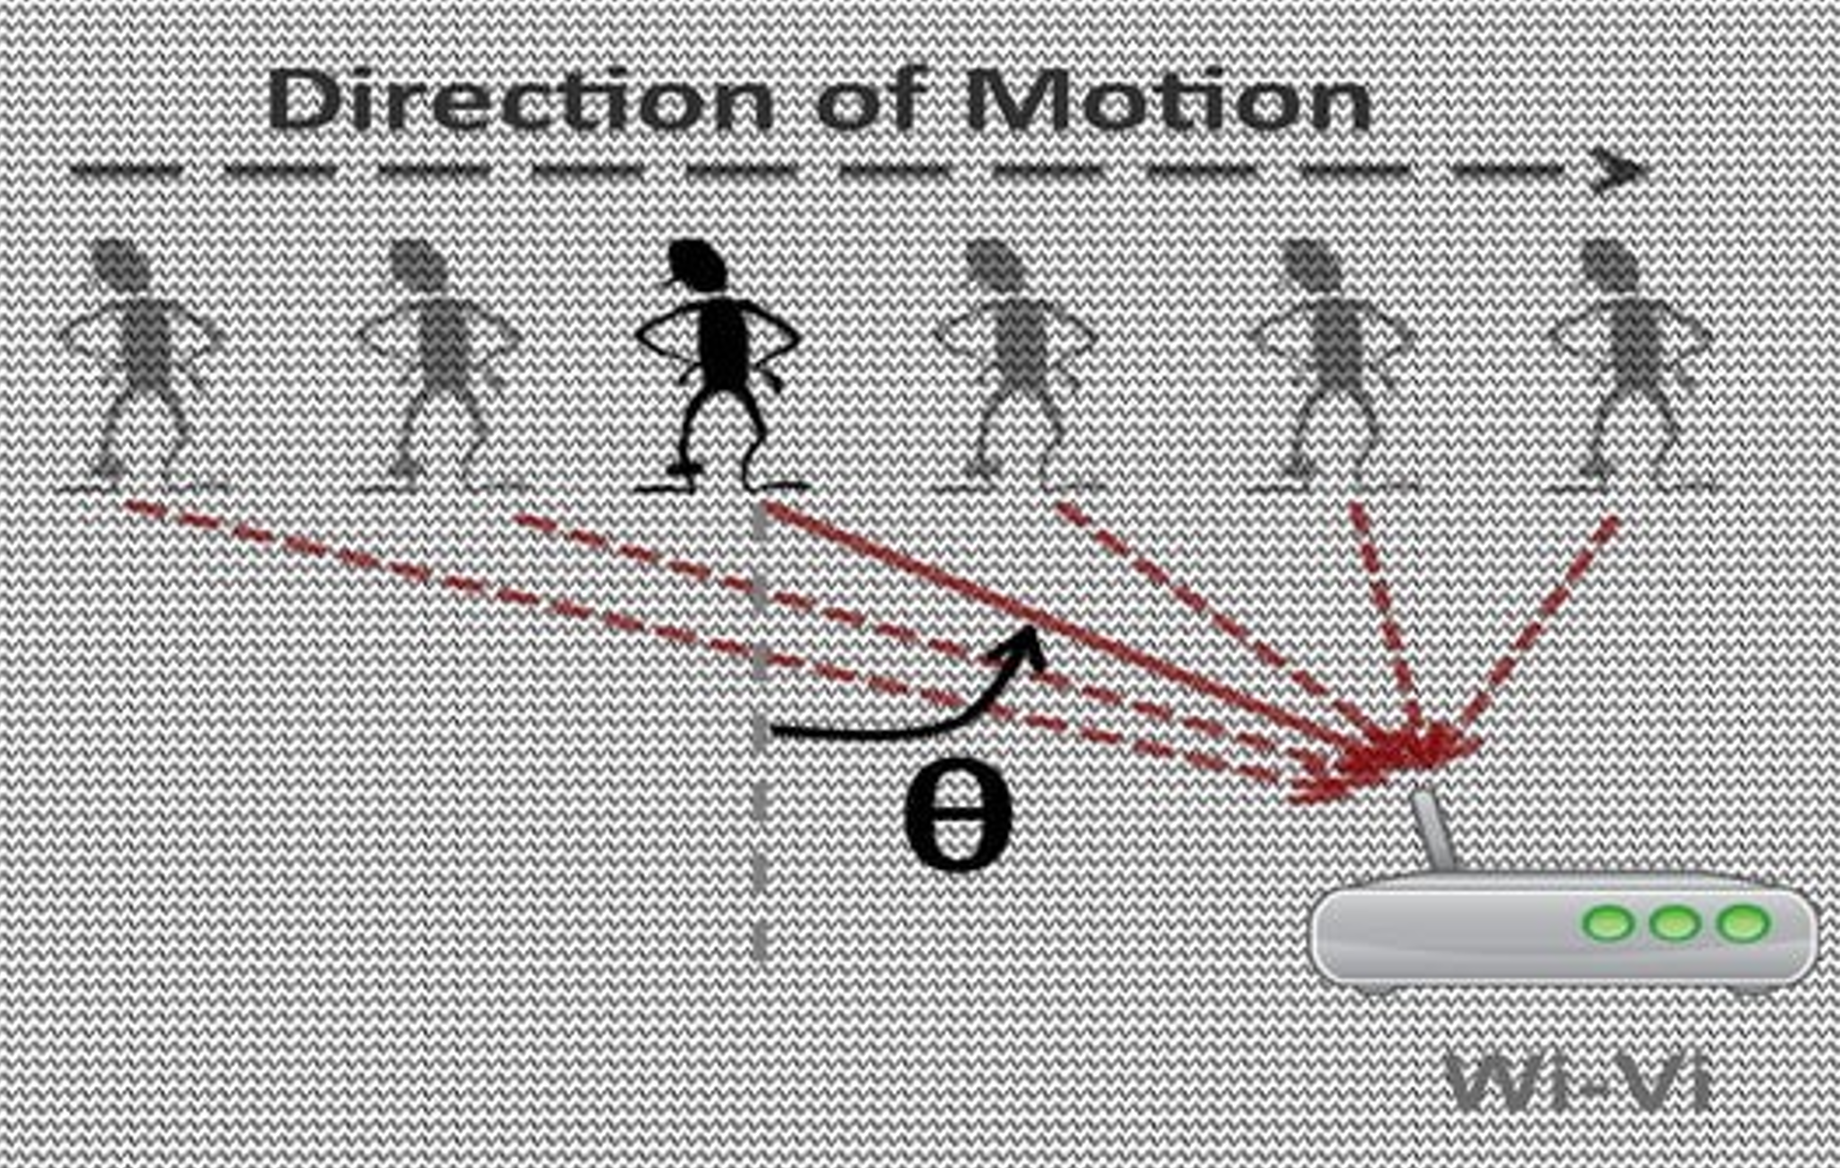
What can Wi-Vi do?
Detect the number of moving humans in a closed room.
Determine the relative locations of moving humans.
Enable communication through a wall without carrying a wireless device.
Identify simple gestures from behind a wall.
Fig.2 Wi-Vi sensing

Slide 7
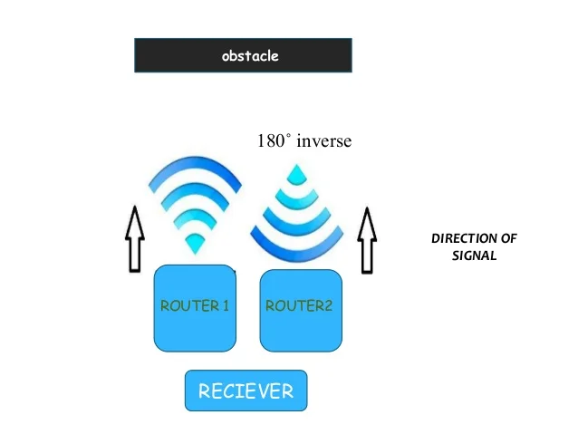
Working of Wi-Vi
Wi-Vi uses two transmitting antennas and a single receiver.
Transmitting signals are low power Wi-Fi signals.
The two antennas transmit almost identical signals, except the second antenna's signal is the inverse of the first, resulting in interference.
Fig. 3 Working of Wi-Vi

Slide 8
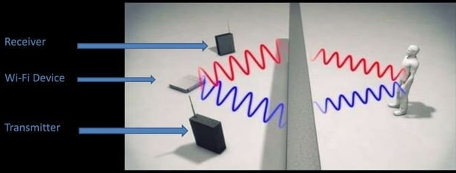
Wi-Vi Design and Usage
Incorporates two main components: MIMO nulling to eliminate wall flash and inverse SAR technique for tracking moving objects.
Can be used in two modes: Image and track moving objects behind a wall, or function as a gesture-based interface for human communication.
Fig.4 Wi-Vi design

Slide 9
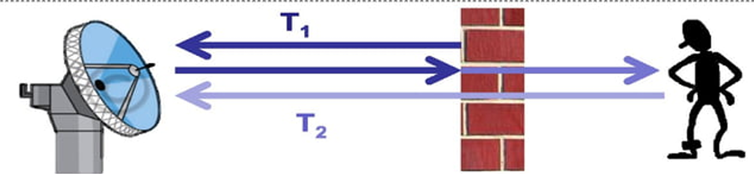
Challenges Faced in Designing Wi-Vi
Challenge #1: "Flash" Effect
RF signals penetrate walls:
Reflect off objects on other side of wall.
Distinguish reflectors by their arrival times.
At low bandwidth:
Wall reflection much stronger than reflections coming from behind the wall.
Flash effect: wall reflection saturates the ADC.
Fig.5 Flash effect

Slide 10
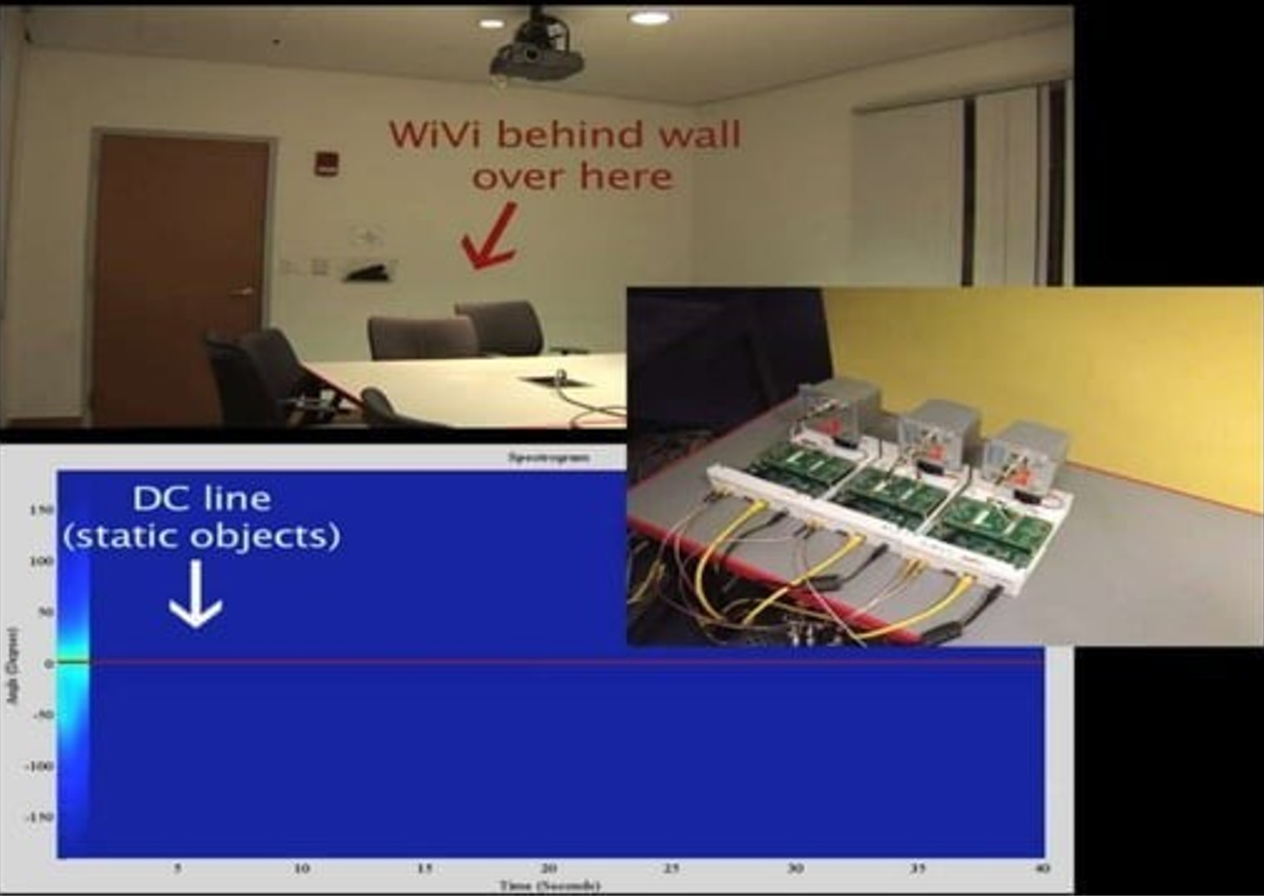
Challenge #2: Identifying and tracking humans
Traditional System: Array of Spaced Antennas.
Previous attempts to track moving targets through walls have done so using an array of spaced antennas.
This would be too expensive and bulky.
Fig.6 Identifying and tracking humans

Slide 11
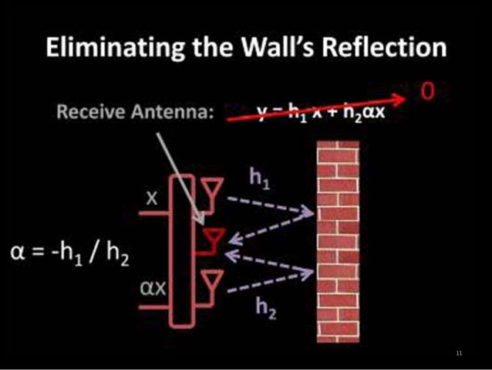
Methodology
How Can We Eliminate the Wall's Reflection?
Wi-Vi Interference Nulling
Cancels wall reflections and direct signal.
Increases sensitivity to reflections.
Nulling to remove the flash
MIMO Systems Pre-Code Transmissions
Can cancel signal received at specific antenna.
Eliminates flash effect and direct signal.
Enables Wi-Vi to capture reflections with minimal interference.
Fig.7 Eliminating the Wall’s Reflection

Slide 12
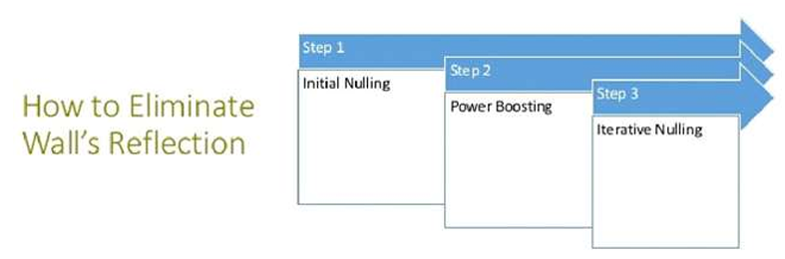
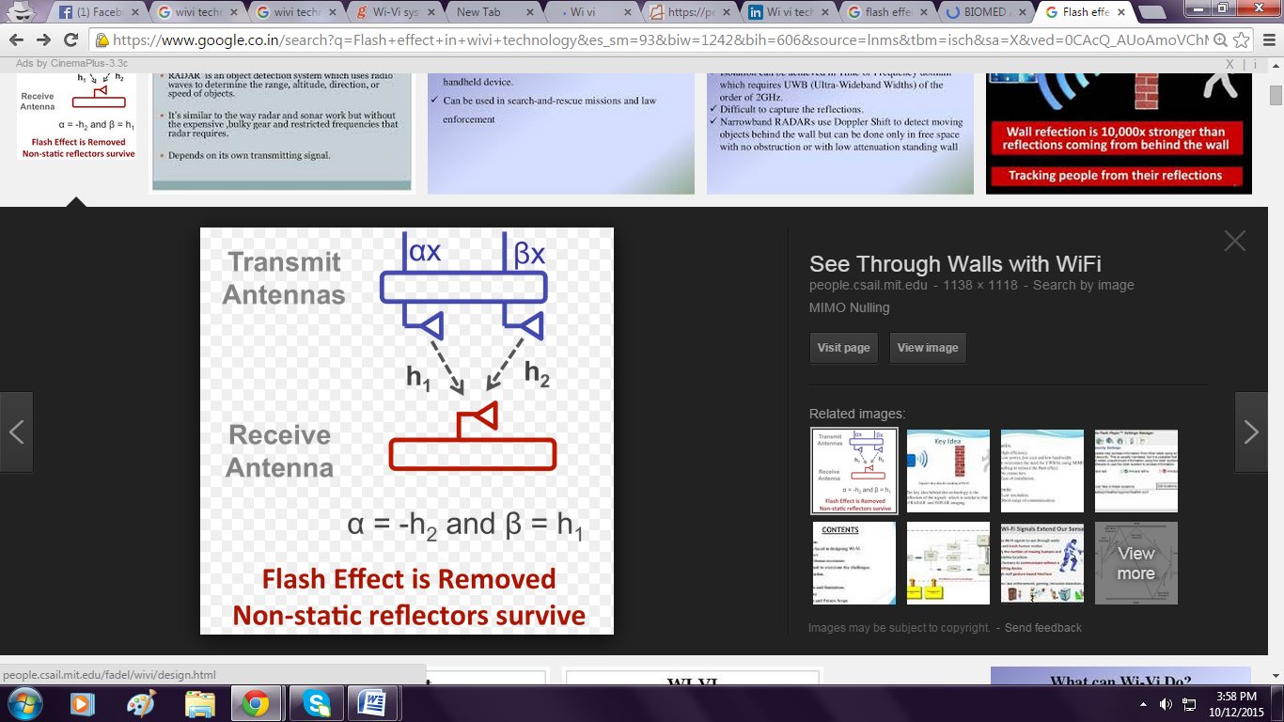
NULLING MIMO: To remove flash
INITIAL NULLING: Channel Estimation
Tx ant. 1 sends x; Rx receives y; hˆ1 ← y/x
Tx ant. 2 sends x; Rx receives y; hˆ2 ← y/x
pre-coding: p ← −hˆ1/hˆ2
POWER BOOSTING:
Tx antennas boost power Tx ant. 1 transmits x, Tx ant.
2 transmits px concurrently
ITERATIVE NULLING:
i ← 0
repeat
Rx receives y; hres ← y/x
if i even then
hˆ1 ← hres + hˆ1
else
hˆ2 ←(1 − hres/hˆ1)hˆ2
p ← −hˆ1/hˆ2
Tx antennas transmit concurrently
i ← i + 1
until Converges
Fig.8 Steps for Elimination of FLASH effects
Fig.9 Nulling MIMO

Slide 13
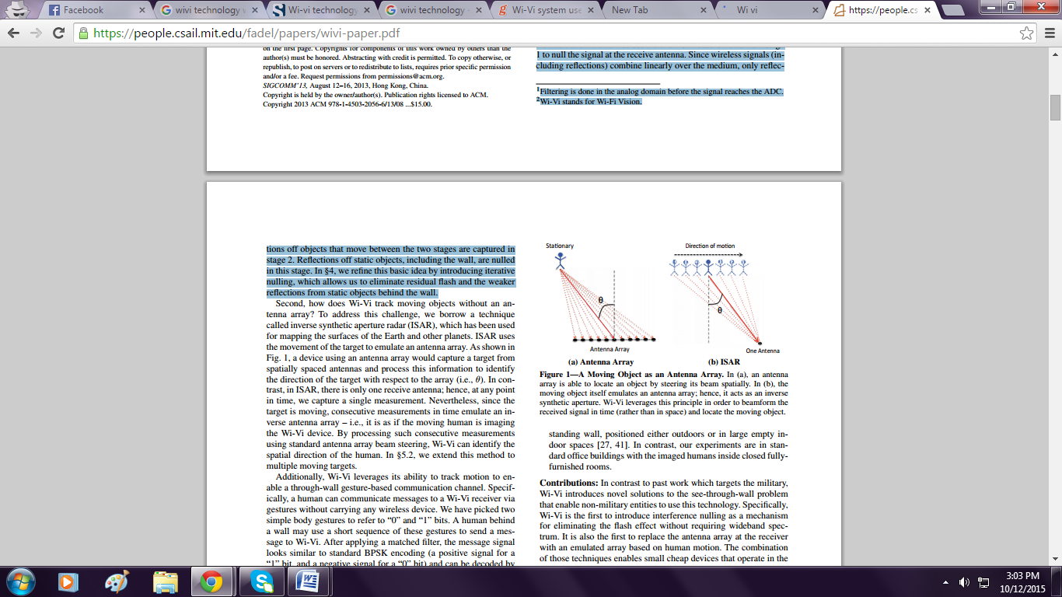
How Can we track the movement of Humans?
ISAR Technique for Human Motion Tracking
Inverse Synthetic Aperture Radar (ISAR) technique uses a person's reflection of transmitted signal to track human motion.
The device captures consecutive time samples and treats them as spatial samples.
Standard antenna array processing identifies the relative angle of the person's motion.
The method can track multiple humans using the smoothed MUSIC algorithm.
Fig.10 Technique for human motion tracking

Slide 14
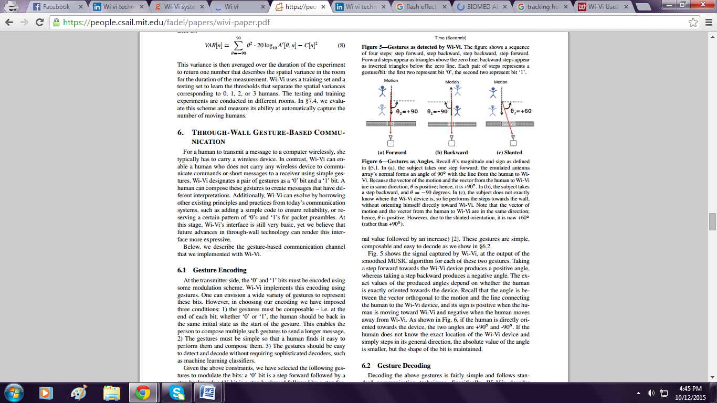
Through-Wall Gesture-Based Communication
• Wireless message sending via wall gestures.
• Uses two body gestures: 'o' and ‘1' bits.
• Human behind a wall sends message to Wi-Vi.
• Message signal resembles standard BPSK encoding.
• Decoded signal sign based on signal sign.
Fig.11 Through-Wall Gesture-Based Communication

Slide 15
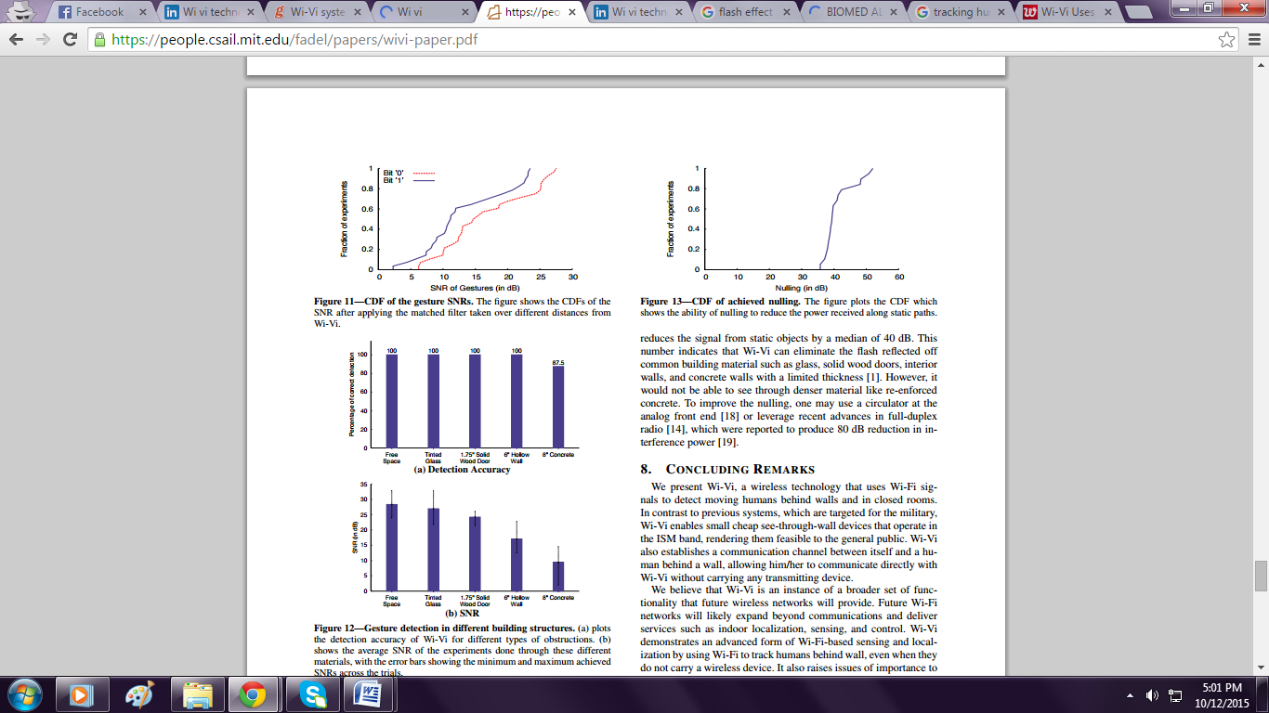
How can we track using reflections?
Human reflects the signal, it's as if he is the source of that signal.
We know that if you want to track an RF source, you can do that using an antenna array.
By steering the beam of the array, we can find the direction of from which the signal is coming.
Now, when a person moves, that direction would change, and we are able to track him.
Fig.12 Cdf of The Gesture Sensors & Cdf of Achieved Nulling

Slide 16
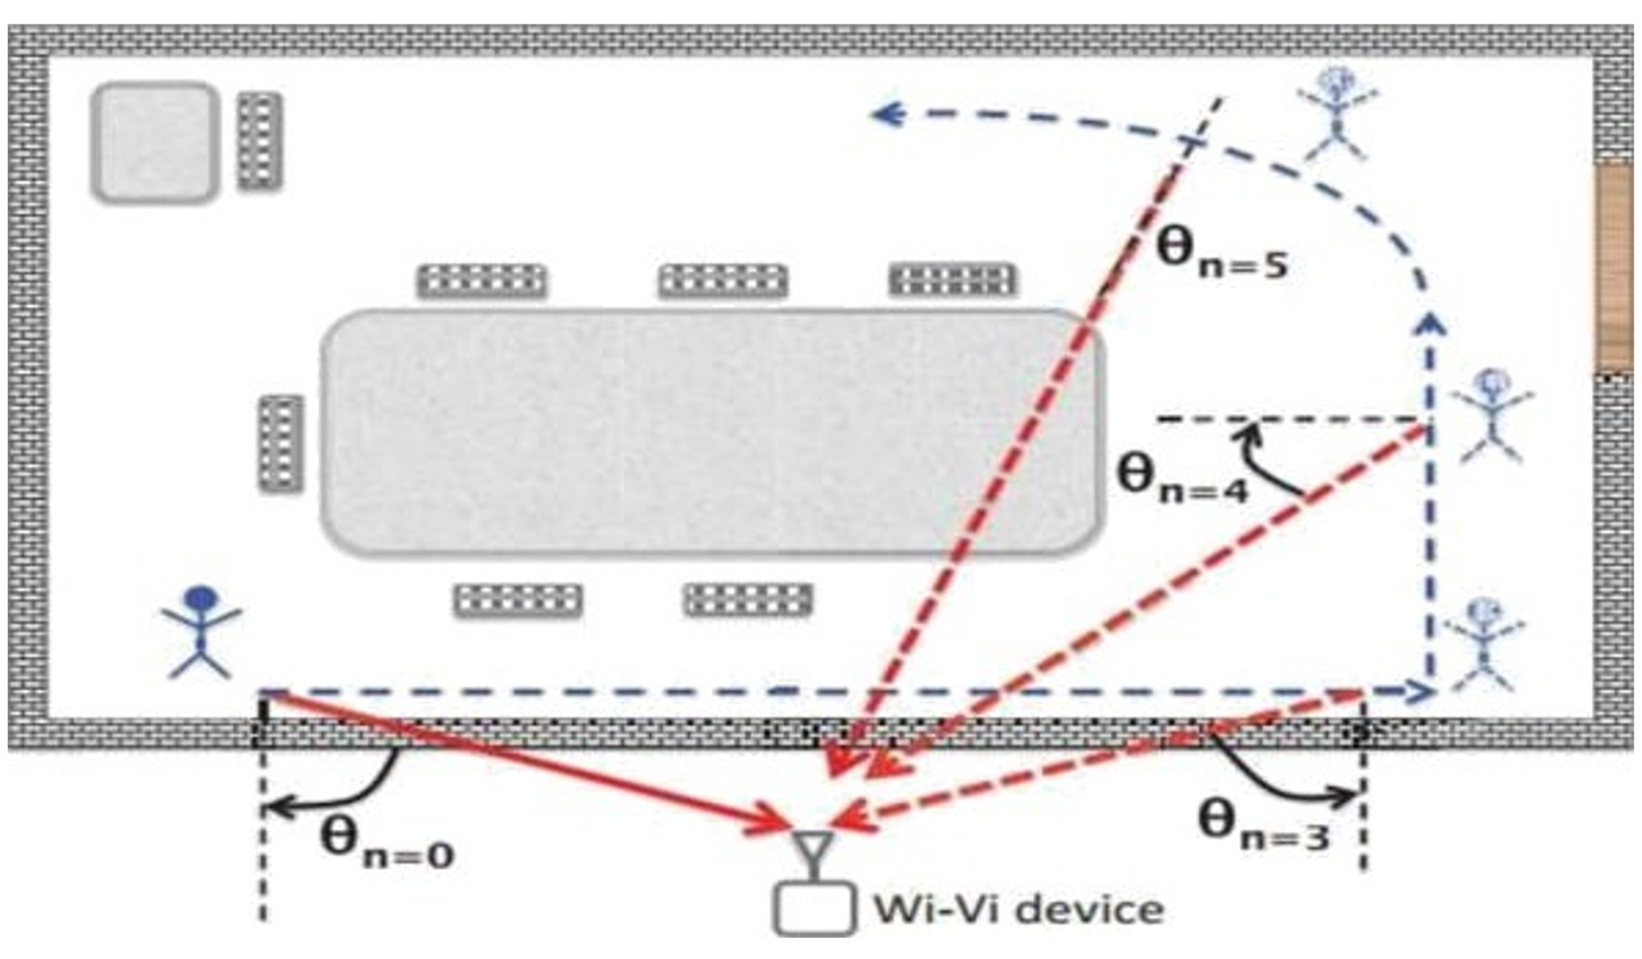
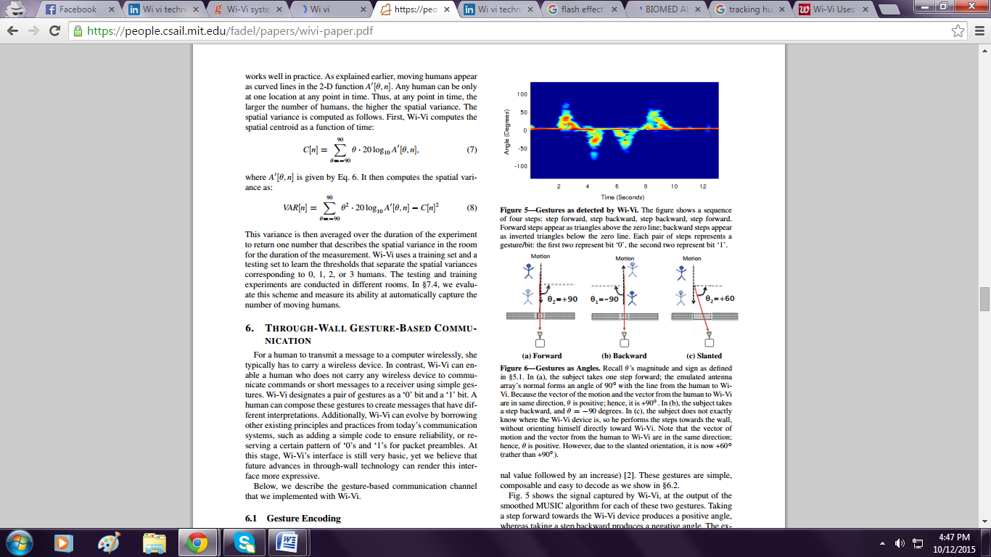
Wi-Vi Setup & Implementation
Fig.13 Wi-Vi setup & output
Any objects that the signals hit including the wall create identical reflections, they too are cancelled out by this nulling effect.
Only those reflections that change between the two signals, such as those from a moving object, arrive back at the receiver.

Slide 17
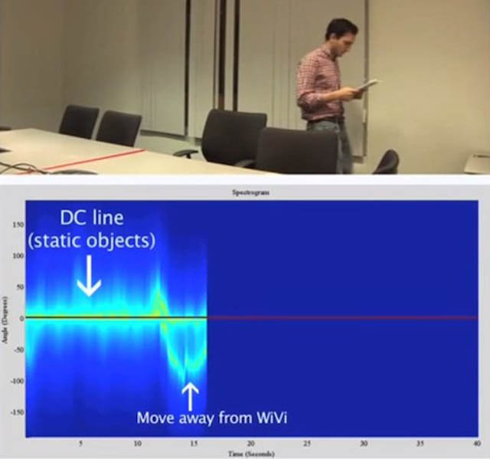
Results
A prototype of Wi-Vi setup used by Dina Katabi gave the following results:
Wi-Vi can detect objects and humans moving behind opaque structural obstructions.
This applies to 8" Concrete Walls, 6" Hollow walls and 1.75" solid wooden doors.
Wi-Vi depends upon the amount of movement.
To achieve a narrow beam, the human needs to move by about 50cm.
Fig.14 Output of Wi-Vi

Slide 18
Applications
Military purpose.
Monitoring situations in hospitals.
Personal security.
Smart Sensing.
Rescue operations.
User Interface Design.

Slide 19
Advantages
Wi-Vi is relatively a low-power, low-cost, low- bandwidth, and accessible to average users.
Wi-Vi requires only few MHz of bandwidth and operates in the same range as Wi-Fi. It operates in ISM band.
Wi-Vi can perform through-wall imaging without access to any device the other side of the wall.
Extend human vision beyond the visible electromagnetic range, allowing us to detect objects in the dark or in smoke.
Limitations
Display has very low resolution.
We cannot detect humans behind concrete walls thicker than 8".
To achieve a narrow beam the human needs to move by about 50cm.

Slide 20
Conclusion
Wi-Vi Wireless Technology Overview
Uses Wi-Fi signals to detect human movement.
Unlike previous military-focused systems, enables affordable, see-through-wall devices.
Operates in the ISM band, making it accessible to the public.
Future Scope
Wi-Vi could be built into a Smartphone or a special handheld device.
Evolution of seeing humans through denser building material and with a longer range.
High quality images.

Slide 21
References
Sudarshan Adeppa, “Detection of Objects across the Walls with Wi-Fi Technology”, International Journal on Emerging Technologies, 2015.
K. Chetty, G. Smith, and K. Woodbridge, “Through-the-wall sensing of personnel using passive bistatic Wi-Fi radar at standoff distances,” IEEE Trans. Geoscience and Remote Sensing, 2012.
Adib, Fadel, and Dina Katabi, “See through Walls with Wi-Fi,” Proceedings of the ACM SIGCOMM Conference, 2013.
S. Ram and H. Ling, “through-wall tracking of human movers using join doppler and array processing,” IEEE Geoscience and Remote Sensing Letters, 2008.
Prerna Garg, Shikha, “Wi-Vi Technology”, International Journal of Advance Research In Science And Engineering, Vol. No.2, Issue No.9, September 2013.

Slide 22


